Slide 1
LINQ Language Integrated Query Chapter 17
Book: ADO.NET 4 C#
© 2011, Mike Murach & Associates, Inc.

Slide 2
Advantages of using LINQ
Integrates query language into C#, instead of mixing 2 languages in one source file
Provides IntelliSense, syntax checking, and debugging support
Lets you use one language to query different types of data sources
Provides designer tools that create object-relational mappings

Slide 3
Evolution of Dealing with OO C# and SQL Databases and Query Language
Write communications code and send appropriate messages to SQL Server, write very specific code to deal with the data structure returned (every program writes its own “ADO” code)
ADO.NET – Complex Classes map SQL interactions (SQLCommand, DataReader)
Write some ADO object properties (as C# strings)
Cycle thru Reader rows or bind to smart display objects
ADO DataAdapter with in memory DataSets
Able to deal with multiple tables and their relationships
Use Typed DataTables and can refer to Tables and Fields using OO “dot” notation, compile time checking
BUT still setting up read and write commands using SQL Query language strings
Program data maps 1to 1, directly to the table and row structure of the database
LINQ - Language Integrated Query
Native C# syntax for reading/writing to a SQL database (or other types of store), no more “SQL Query language””
Data is returned in objects, (but program data still maps 1to1 to the table and row structure of the database)
Entity Framework – create/use data as C# objects
Program data is structured in objects, as an OO programmer would want it
SQL is pushed out of sight, it becomes a backing store that the Entity Framework object model uses, but our code never sees it.
There does not have to be a 1-1 mapping of some object’s data and some one table, an object might own just 2 of 7 rows in one table, 3 rows from another, and 1 row from a third table.
a) Data in C# object model is “pure”
b) Data in SQL is normalized and efficient
c) The Entity Framework does the mapping between them

Slide 4
To learn LINQ
We need to learn a new, C# specific query language (just a few phrases)
We need to dig into a bit of OO technology to deal with “System.Collections.IEnumerable”
We need to use a particular code construct to get at the data (foreach)
And again, we can reference table names, field names, and fields in “related” tables by simply use the “.something” notation.

Slide 5
IEnumerable
IEnumerable is the base interface for all non-generic collections that can be enumerated.
There is also IEnumerable<T> for the generic version of this interface
IEnumerable contains a single method,
GetEnumerator, which returns an IEnumerator.
IEnumerator provides the ability to iterate through the collection by exposing a
Current property
MoveNext method
Reset method.

Slide 6
LINQ providers
Providers translate queries into whatever commands the data source requires.
They convert the data that’s returned from a data source to the objects defined by the query.
When updating, they convert object’s data back to data in the required format needed to update the original source of the data.
LINQ Providers provided with C#: ( the –’s are mine)
LINQ – to – Objects (such as a List<t>) (Collections)
LINQ – to – DataSet
LINQ – to – ADO.NET
LINQ – to – XML
LINQ – to – SQL (SQL Server) (Chapter 17)
LINQ – to – Entities (any relational database) (Chapter 18)

Slide 7
LINQ is implemented …
As a series of extension methods that are defined by the Enumerable and Queryable classes and these particular methods are called query operators.
Extension methods enable you to "add" methods to existing types without creating a new derived type, recompiling, or otherwise modifying the original type.
Extension methods are a special kind of static method, but they are called as if they were instance methods on the extended type.
For client code written in C#, there is no apparent difference between calling an extension method and the methods that are actually defined in a type.
The most common extension methods are the LINQ standard query operators that add query functionality to the existing System.Collections.IEnumerable and System.Collections.Generic.IEnumerable<T> types.
While you can call these query operators directly with your code, it is normal to (and we will only) use the supplied C# built in clauses.
When you use a C# clause to code a LINQ query, the result is called a query expression
These C# clauses look very similar to the SQL language …

Slide 8
C# clauses for working with LINQ
from
select (In LINQ, the SELECT and FROM are in reverse order)
where
orderby
let
join
group
When using these clauses to create query expressions, VS helps get the coding correct with IntelliSense and type checking as you edit
Finds errors before run-time.

Slide 9
Open up FirstLINQproject.ppxt

Slide 10
The three stages of a query operation
Q1 - Get the data source.
Q2 - Define the query expression.
Q3 – Execute (use) the query to return the results.

Slide 11
A LINQ-to-Objects query example where the data is in a generic list (with deferred execution)-1
Q1 - statement that declares and populates a list
First get the data source. Depends on what type of data source.
For this generic List<T>, declare a var to hold the list
Then call some method that will return the list
List<Invoice> invoiceList = InvoiceDB.GetInvoices();
// assumes there is an InvoiceDB class with a GetInvoices() method that will return a List<objects of type Invoice>
// so now we “have” the data

Slide 12
A LINQ-to-Objects query example where the data is in a generic list (with deferred execution)-2
Q2 - statement that defines the query expression
Define the query expression
Identify the data source from (invoiceList)
And specify what data is too be retrieved from it (invoice objects, where their total is > 20000)
Specify an orderby
var invoices = from invoice in invoiceList
where invoice.InvoiceTotal > 20000
orderby invoice.InvoiceTotal descending
The query expression is stored in a query variable (invoices)
Must be this way as the query is not executed here, it is just defined (deferred ex)
This query variable, invoices, is not given a pre-defined type, it gets its type set based on the type of elements returned from the right side of the statement.
In this case, invoices is given the type IEnumerable<Invoice>
For this to work, the data source must be an enumerable type, meaning, it implements the IEnumerable<T> interface (or another one, the IQueryable<T> interface which is a superset
(The List<> class does implement the IEnumerable<T> interface )

Slide 13
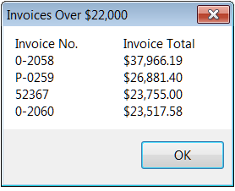
A LINQ-to-Objects query example where the data is in a generic list (with deferred execution)-3
Q3 - Code that executes the query
Typically use a foreach loop
(In this example, we are just taking the query results and appending them all to one string.)
string invoiceDisplay = "Invoice No.\tInvoice Total\n";
// header line
foreach (var invoice in invoices)
{
invoiceDisplay += invoice.InvoiceNumber + "\t\t" + // first col
invoice.InvoiceTotal.ToString("c") +
"\n"; // second column appended to the string
}
MessageBox.Show(invoiceDisplay, "Invoices Over $20,000");

Slide 14
Deferred or Immediate Execution
This example uses deferred. The query is saved in a query variable invoices but not executed.
It does get executed when the code tries to access the individual elements returned by the query
Such as when the query (invoices)is used in the foreach
In contrast, immediate execution occurs if a method that requires access to the individual elements is executed on the query expression (such as an aggregate function)
Get a count of the number of elements, using the .Count method on the query expression would force an immediate execution

Slide 15
Learning the LINQ syntax for query expressions
Next slides show several examples (right from the book)
All use LINQ-to-Objects so can focus on the syntax, but LINQ-to-Anything is the same.
Won’t go through these, but consider this reference information to come back to when you have to design a query

Slide 17
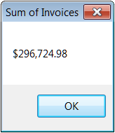
Notes:
17

Slide 19
// uses this awful string concatenation to create
// a “form” looking output.

Slide 20
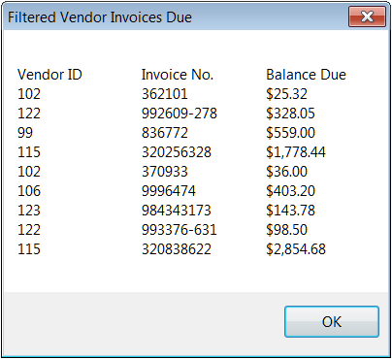
Notes:
20

Slide 23
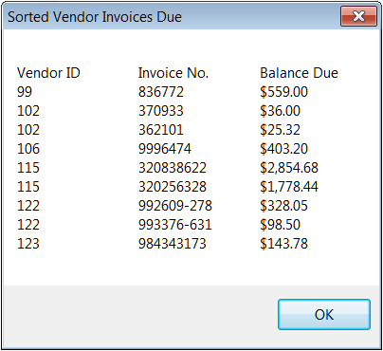
Notes:
23

Slide 29
Notes:
29

Slide 32
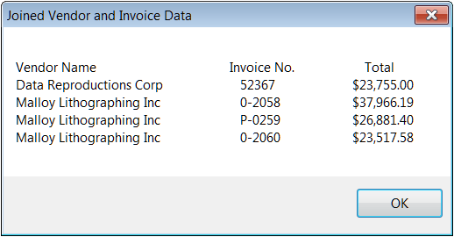
Notes:
32

Slide 36
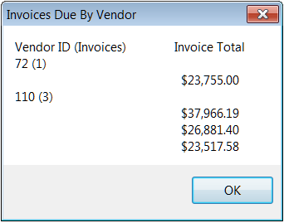
Notes:
36

